Slide 1
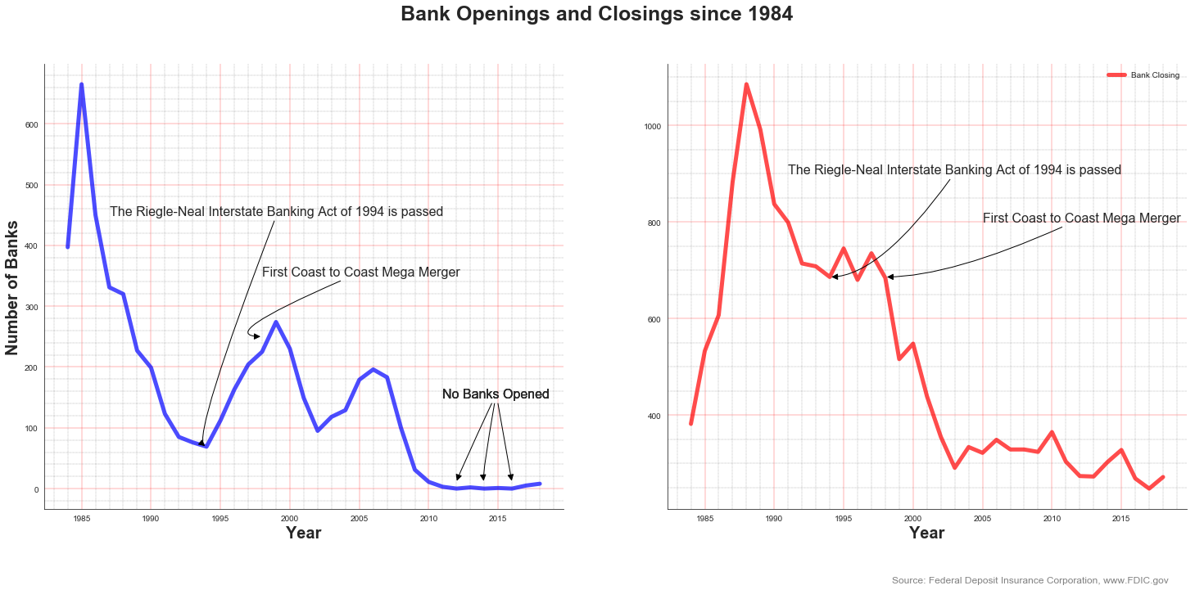
Legal Changes, Economies of Scale, and the Rise of Nationwide Banking

Slide 2
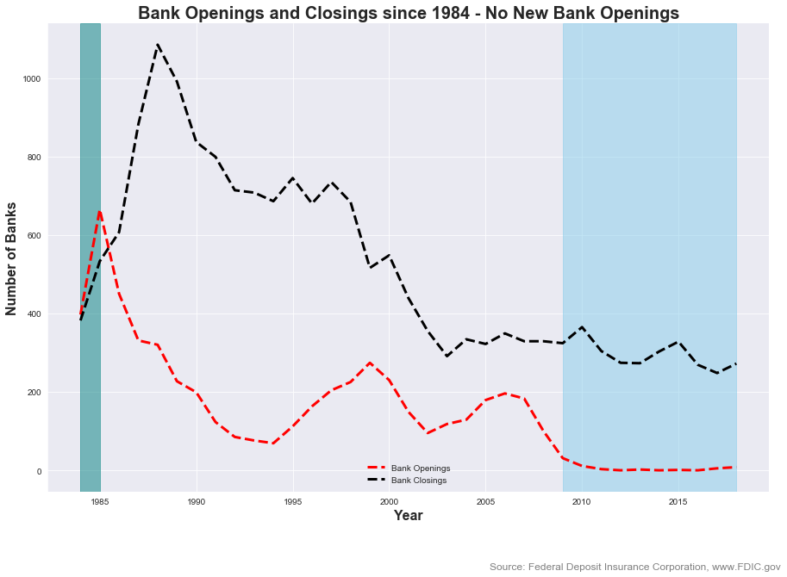
As highlighted in light blue, there are virtually no bank openings for the past 10 years yet they continue to close at a steady pace. Highlighted in teal showcases how for two short years (1984 and 1985) there were more bank openings than closings.

Slide 3
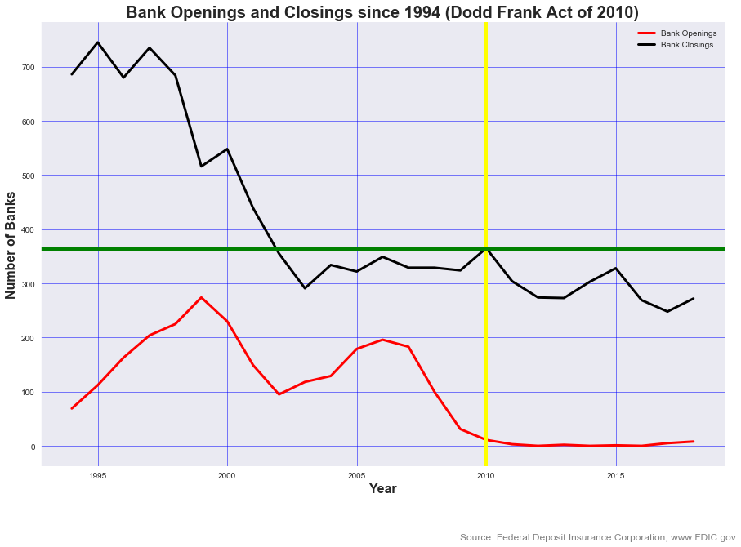
In 1994, Congress passed the Riegle - Neale Interstate Banking and Branching Efficiency Act, which allowed for the phased removal of restrictions on interstate banking. Since then, Congress passed the Dodd-Frank Act in 2010, forcing all banks to face greater regulation, in particular community banks. This raises costs and has the potential of further accelerating the closure rate of community banks.

Slide 4
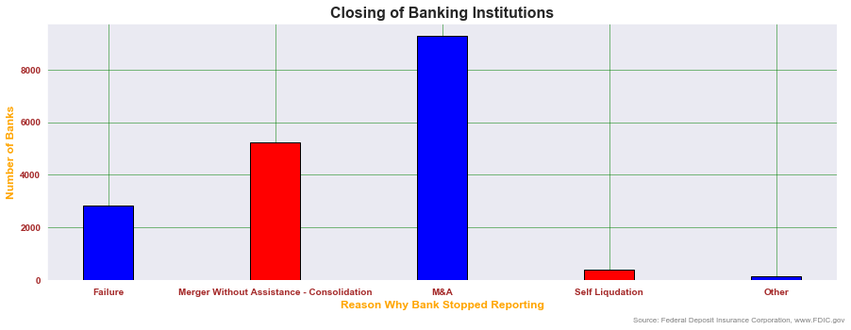
The closing of banking institutions was a result of a number of different scenarios - M&A being the leading reason. Consolidation - merger without assistance is an M&A transaction as well, although the process is somewhat different as the consolidation process commands a different ownership stake and operational outlook. The standard acquisition transaction see's the acquired institutions join the portfolio of the acquirers bank holdings.

Slide 5
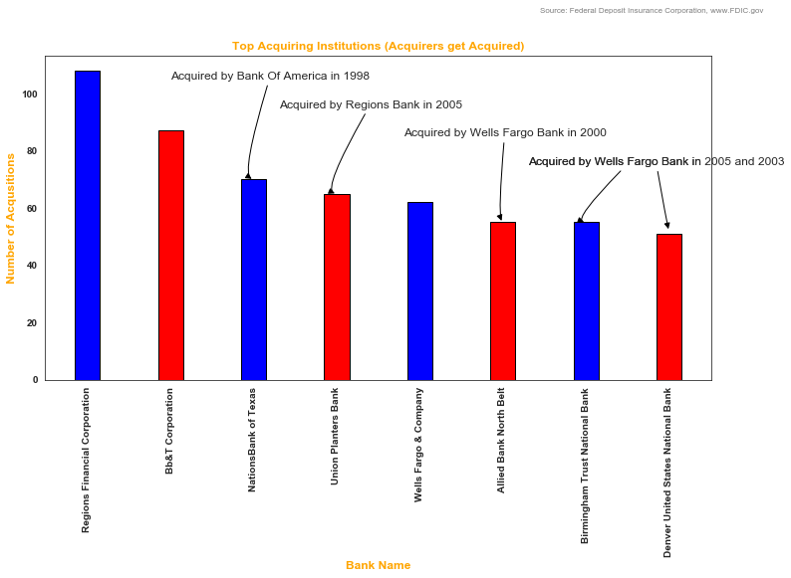
These institutions were responsible for the most M&A transactions in the community banking industry
If 5 out of the 8 top community bank acquirers were themselves acquired, then the actual acquiring rates are much higher for the largest institutions.

